Slide 1
Chapter 8
Conflict Management
Skills
This multimedia product and its contents are protected under copyright law. The following are prohibited by law:
any public performance or display, including transmission of any image over a network;
preparation of any derivative work, including the extraction, in whole or in part, of any images;
any rental, lease, or lending of the program.

Slide 2
Learning Objectives After reading this chapter, you should be able to:
8.1 Define interpersonal conflict.
8.2 Identify commonly held myths about interpersonal conflict.
8.3 Compare and contrast three types of interpersonal conflict.
8.4 Describe the relationship between conflict and power.
8.5 Describe five conflict management styles.
8.6 Identify and use conflict management skills to help manage emotions, information, goals, and problems when attempting to solve interpersonal differences.

Slide 3
Conflict Defined (1 of 5) 8.1 Define interpersonal conflict.
Conflict Defined
Interpersonal conflict: an expressed struggle between at least two interdependent people who perceive incompatible goals, scarce resources, or interference in the achievement of their goals.
Notes:
Interpersonal conflict: an expressed struggle between at least two interdependent people who perceive incompatible goals, scarce resources, or interferences in achievement of their goals

Slide 4
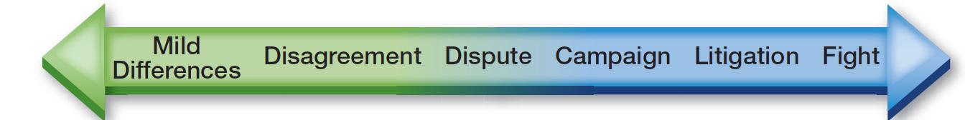
Conflict Defined (2 of 5)
Conflict Elements
An expressed struggle
Between at least two interdependent people
Perceive Incompatible goals, scarce resources, and interference
Achieving a goal
Figure 8.1 The Struggle Spectrum
Notes:
Interdependent: dependent on each other; one person’s actions affect the other person

Slide 5
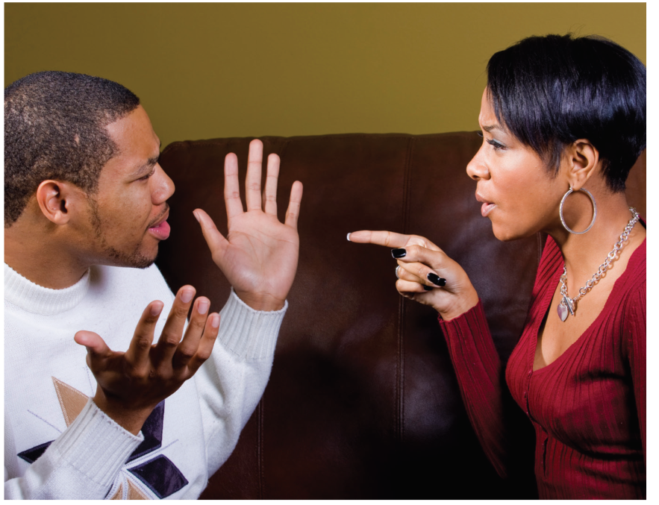
Conflict Defined (3 of 5)
Unresolved and poorly managed interpersonal conflict is a significant predictor of an unsatisfactory interpersonal relationship.

Slide 6
Conflict Defined (4 of 5)
Conflict Triggers
Criticism
Feeling entitled
Perceived lack of fairness
More perceived costs than rewards
Different perspectives
People may have different perspectives about power (who is in charge), social issues (such as politics and religion), personal flaws (such as using drugs or alcohol, smoking, or laziness), distrust (concern about whether one person is telling the truth), intimacy (differences about the frequency and timing of sex), and personal distance (as evidenced by the amount of time each person commits to the relationship)
Stress and lack of rest
Dialectical tension
Being separate and connected
Being open and closed
Notes:
Conflict trigger: a perceived cause of conflict
Dialectical tension: tension arising from a person’s need for two things at the same time

Slide 7
Conflict Defined (5 of 5)
Conflict as a Process
Conflict has a source, beginning, middle, end and aftermath.
Source: prior conditions
Beginning: frustration awareness
Middle: active conflict (expressed)
End: resolution (management)
Aftermath: follow-up
Constructive conflict
Destructive conflict
Notes:
Constructive conflict: conflict that helps build new insights and establishes new patterns in a relationship
Destructive conflict: conflict that dismantles rather than strengthens relationships

Slide 8
Conflict Myths (1 of 2) 8.2 Identify commonly held myths about interpersonal conflicts.
Four major conflict myths
Myth 1: Conflict Is Always a Sign of a Poor Interpersonal Relationship
Conflict is a normal part of all interpersonal relationships.
Overly polite, stilted conversation is more likely to signal a problem than are periodic disagreements.
Myth 2: Conflict Can Always Be Avoided
Different perspectives mean that we won’t always see eye to eye.

Slide 9
Conflict Myths (2 of 2)
Four major conflict myths
Myth 3: Conflict Always Occurs Because of Misunderstandings
A disagreement, rather than a misunderstanding, may be the trigger in a conflict.
Myth 4: Conflict Can Always Be Resolved
Some conflicts cannot be resolved; some disagreements are too intense.
Not all disagreements can be resolved by listening harder or paraphrasing your partner’s message.
Some disagreements are so intense, and the perceptions so fixed, that individuals may have to agree to disagree and live with it.

Slide 10
Conflict Types (1 of 2) 8.3 Compare and contrast three types of interpersonal conflict.
Three types of interpersonal conflict
Pseudoconflict
Triggered by a lack of understanding and miscommunication.
Simple conflict
Stems from different ideas, definitions, perceptions, or goals.
Ego conflict
The original issue is ignored as partners attack each other’s self-esteem.
Notes:
Pseudoconflict: conflict triggered by a lack of understanding and miscommunication
Simple conflict: conflict that stems from different ideas, definitions, perceptions, or goals
Ego conflict: conflict in which the original issue is ignored as partners attack each other’s self esteem

Slide 11

Conflict Types (2 of 2)
Pseudoconflict is simply a misunderstanding. Your partner may communicate confusion by facial expressions or other nonverbal behavior. Pseudoconflict can be resolved if partners ask for clarification, listen between the lines, and work to establish a supportive climate.
Notes:
Pseudoconflict: conflict triggered by a lack of understanding and miscommunication

Slide 12
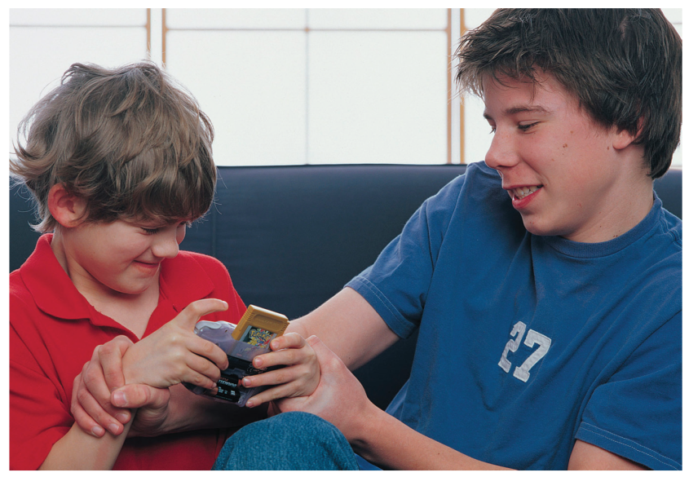
Conflict and Power (1 of 4) 8.4 Describe the relationship between conflict and power.
Conflict and Power go hand in hand
Interpersonal power
degree to which a person is able to influence his or
her partner
Underlying many interpersonal
conflicts is the question of who has
power to make decisions.
Notes:
Interpersonal power: degree to which a person is able to influence his or her partner

Slide 13
Conflict and Power (2 of 4)
Power Principles
Power exists in all relationships. When you talk, you are attempting to exert power over other people, even if it is just to get them to listen to you.
Power derives from the ability to meet a person’s needs.→ Both people in a relationship have some power.
Dependent relationship- relationship in which one partner has a greater desire for the other to meet his or her needs. The other has more power.
Power is circumstantial.
Power is negotiated… which individual will have decision-making responsibility over what issues.
Notes:
Dependent relationship: relationship in which one partner has a greater desire for the other to meet his or her needs

Slide 14
Conflict and Power (3 of 4)
Vs. Other Power Sources
Reward power-based on a person’s ability to satisfy our needs
Legitimate power-based on respect for a person’s position
Referent power-comes from our attraction to another person, or the charisma a person possesses
Expert power-based on a person’s knowledge and experience
Coercive power-based on the use of sanctions or punishments to influence others
Notes:
Legitimate power: power that is Referent power: power that
Expert power: power Reward power: power Coercive power: power

Slide 15
Conflict and Power (4 of 4)
Power to Persuade
Power can manage conflict to achieve goals and meet needs.
Compliance gaining-taking persuasive actions to get others to comply with our goals
Power Negotiation
Power, control, responsibility, and decision making are sources of conflict.
Reflect on your needs and the needs of the other person.
Ideally, partners negotiate a mutually acceptable and rewarding power relationship.
Notes:
Compliance gaining:

Slide 16
Conflict Management Styles (1 of 6) 8.5 Describe five conflict management styles.
Conflict Management Styles
Avoidance
Accommodation
Competition
Compromise
Collaboration
Notes:
Conflict management styles: consistent patters or approaches people use to manage disagreements with others

Slide 17
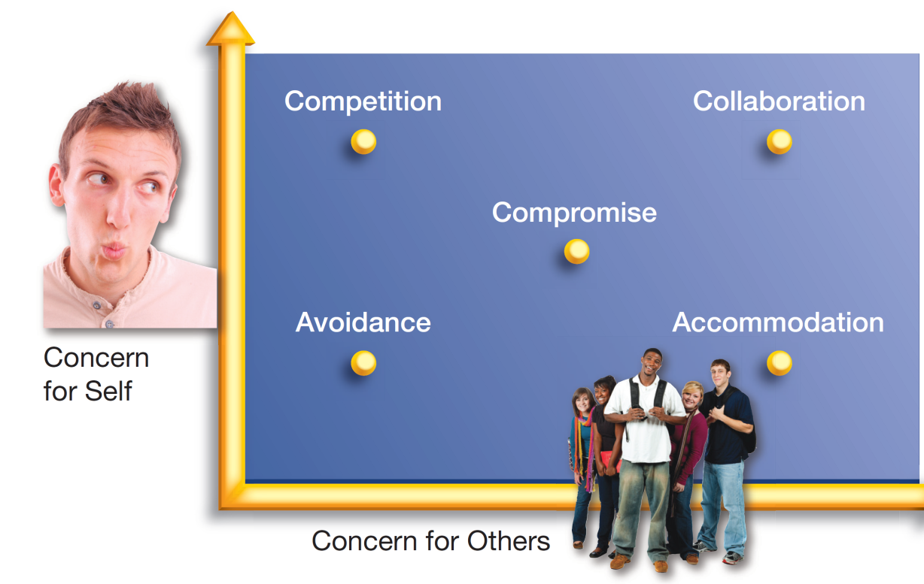
Figure 8.2 Conflict Management Styles: The five conflict management styles in relation to concern for others and concern for self
Notes:
Conflict management styles: consistent patters or approaches people use to manage disagreements with others

Slide 18
Conflict Management Styles (3 of 6)
Avoidance
Might indicate the person has low concern for others as well as himself or herself.
Also called the lose-lose approach.
Demand-withdrawal pattern of conflict management
Occurs because one of the partners in the relationship wants to change the relationship and the other person does not.
Notes:
Avoidance: conflict management style that involves backing off and trying to side-step conflict
Demand-withdrawal pattern of conflict management: pattern in which one person makes a demand and the other person avoids conflict by changing the subject or walking away
Accommodation: conflict management style that involves giving in to the demands of others

Slide 19
Conflict Management Styles (4 of 6)
Accommodation
People just do what others want them to do, sacrificing their own needs.
Also called the lose-win approach.
May result in a pseudosolution.
Notes:
Avoidance: conflict management style that involves backing off and trying to side-step conflict
Demand-withdrawal pattern of conflict management: pattern in which one person makes a demand and the other person avoids conflict by changing the subject or walking away
Accommodation: conflict management style that involves giving in to the demands of others

Slide 20
Conflict Management Styles (5 of 6)
Competition
Stresses winning a conflict at the expense of the other person.
Also called the win-lose approach.
May include threats and warnings.
Compromise
Attempts to find the middle ground to meet the needs of all concerned.
Also called the lose/win-lose/win approach.
Notes:
Competition: stresses winning a conflict at the expense of the other person
Compromise: attempts to find the middle ground in a conflict
Collaboration: uses other-oriented strategies to achieve a solution for all involved

Slide 21
Conflict Management Styles (6 of 6)
Collaboration
To collaborate is to have a high concern for both yourself and others.
Views conflict as a set of problems to be solved rather than a game in which one person wins and another loses.
Notes:
Competition: stresses winning a conflict at the expense of the other person
Compromise: attempts to find the middle ground in a conflict
Collaboration: uses other-oriented strategies to achieve a solution for all involved

Slide 22
Conflict Management Skills (1 of 9) 8.5 Identify and use conflict management skills to help manage emotions, information, goals, and problems when attempting to resolve interpersonal differences.
Manage Your Emotions
Be aware that you are becoming angry and emotionally volatile.
Seek to understand why you are angry and emotional.
Make a conscious decision about whether to express your anger.

Slide 23
Conflict Management Skills (2 of 9)
Manage Your Emotions (continued)
Select a mutually acceptable time and place to discuss a conflict.
Plan your message.
Breathe.
Monitor nonverbal messages.

Slide 24
Conflict Management Skills (3 of 9)
Manage Your Emotions (continued)
Avoid personal attacks, name calling, and emotional overstatement.
Gunny-sacking
Take time to establish rapport.
Use self-talk.
Notes:
Gunny-sacking: dredging up old problems and issues from the past to use them against your partner

Slide 25
Conflict Management Skills (4 of 9)
Manage Information
Clearly describe the conflict-producing events.
Take turns talking.
“Own” your statements by using descriptive “I” language statements that use the word I to express how a speaker is feeling.
Monitor “but” messages
Notes:
“I” language: statements that use the word I to express how a speaker is feeling
“But” messages: statements using the word but that may communicate that whatever you’ve said prior to but is not really true

Slide 26
Conflict Management Skills (5 of 9)
Manage Information (continued)
Use effective listening skills.
Check your understanding of what others say and do.
Be empathic.

Slide 27
Conflict Management Skills (6 of 9)
Manage Goals
Identify your goal and your partner’s goal.
Identify where your goals and your partner’s goals overlap.

Slide 28
Conflict Management Skills (7 of 9)
Manage the Problem
Use principled negotiation strategies.
Separate the people from the problem.
Focus on shared interests.
Generate many options to solve problems.
Base decisions on objective criteria.
Use a problem-solving structure.

Slide 29

Conflict Management Skills (9 of 9)
Manage the Problem (continued)
Develop a solution that helps each person save face.
Making efforts to structure conflict as a problem to be solved through mutual effort can keep the conversation focused on the issues, so that the conflict does not escalate.
Notes:
Face: a person’s positive perception of himself or herself in interactions with others

Slide 30

Conflict Management Skills (8 of 9)
It’s vital to be able to manage your emotions when you find yourself in an interpersonal conflict.

